Slide 1




“The
Shiny New Thing
that
really helps!”
30
5
10
Notes:
I think this is a nice way of summing up 40 years of experience in IT and ITSM.
Ever since I discovered ITIL as the Shiny New Thing I have noticed that as an Industry we are continually looking for the next Shiny New Thing, HOPING it will solve our problems. Agile, DevOps, Lean, ITIL4, ‘Transformation’,
rather than getting the existing things to deliver what they were supposed to deliver.
This started off as a joke.
To confirm my suspicion I announced on linkedin that I would be launching a new framework that would solve all of our problems……I got 8 times the amount of hits I usually get. Finally what I launched was this ‘SNTTRH’ we will see later what this is.
I only have about 40 minutes to cover 40 years worth of painful experience so I am giving you various links to articles.
Throughout presentation you will see these symbols.
You can have a copy of the presentation if you send me a mail, You can click on these symbols in presentation mode and it will open a related article.

Slide 2
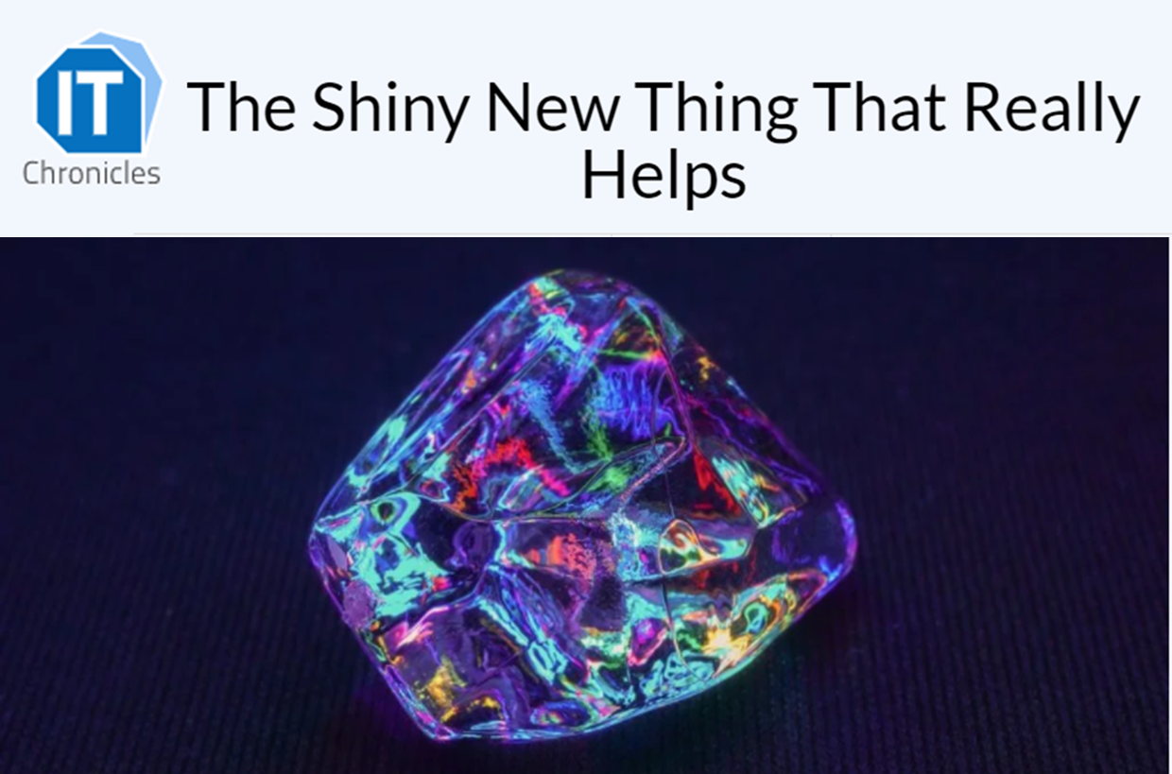






Diamond
These are both carbon
Coal
“The
Shiny New Thing
that
really helps!”
The Shiny New Thing as Promised
..and as delivered (nicely packaged though)
Notes:
However What I often seen again and again in my career is this…
The Shiny New Thing doesn’t always deliver the value as promised.
Here is a diamond and a piece of coal. What do they have in common?
They are both carbon.
Imagine now that carbon is the latest new framework – agile, DevOps, Lean, ITIL4
They promise shiny new value….but in my 40 years of experience the reality is that we often end up getting a lump of coal.
Nicely packaged though, in process flows, procedures and tools. But not delivering the shiny value we had been promised. The Value that we had HOPED we would get.
I wrote two articles around this topic that I will explore further in this session.
In this session I want to look at what happens between here and here, why are we consistently ending up with a lump of coal? What can we do differently?
I have the answer!!! The Shiny New Thing that REALLY helps.
Which I will show you at the end of the session, I will also be giving you some proven tips….
Things will NEVER be the same again. Diamonds will rain down upon us…Yeah right!
But first a look back at my career in terms of the transformation we have made and the shiny new things we have adopted….

Slide 3
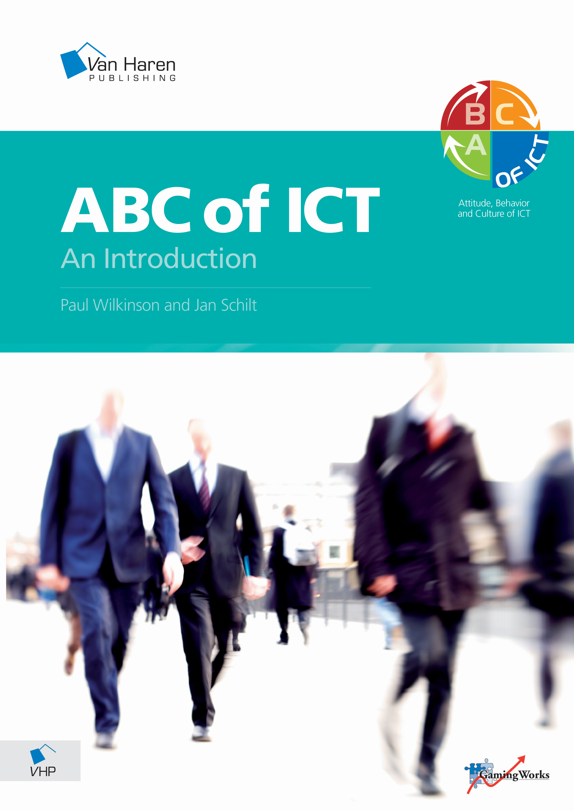
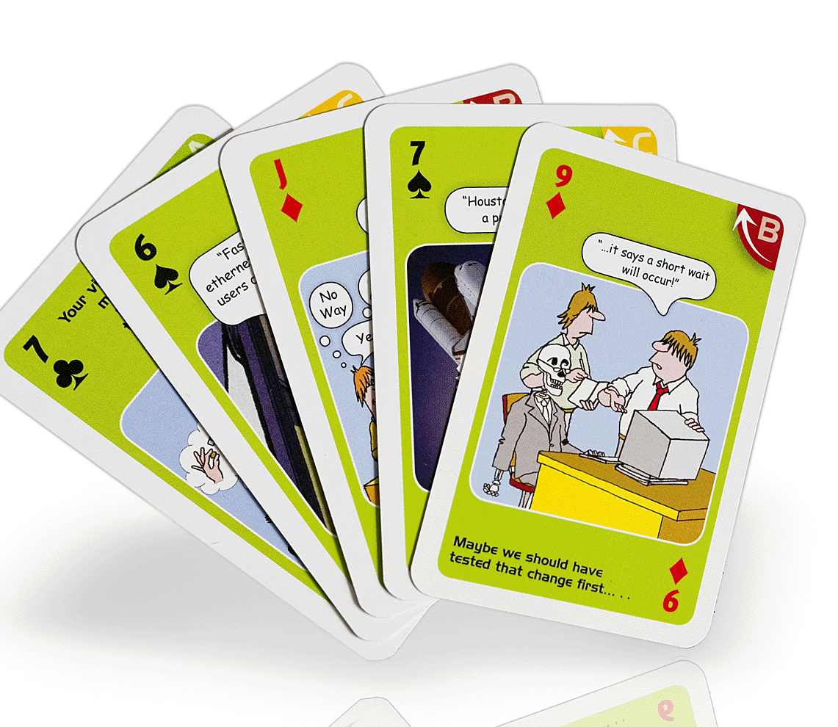
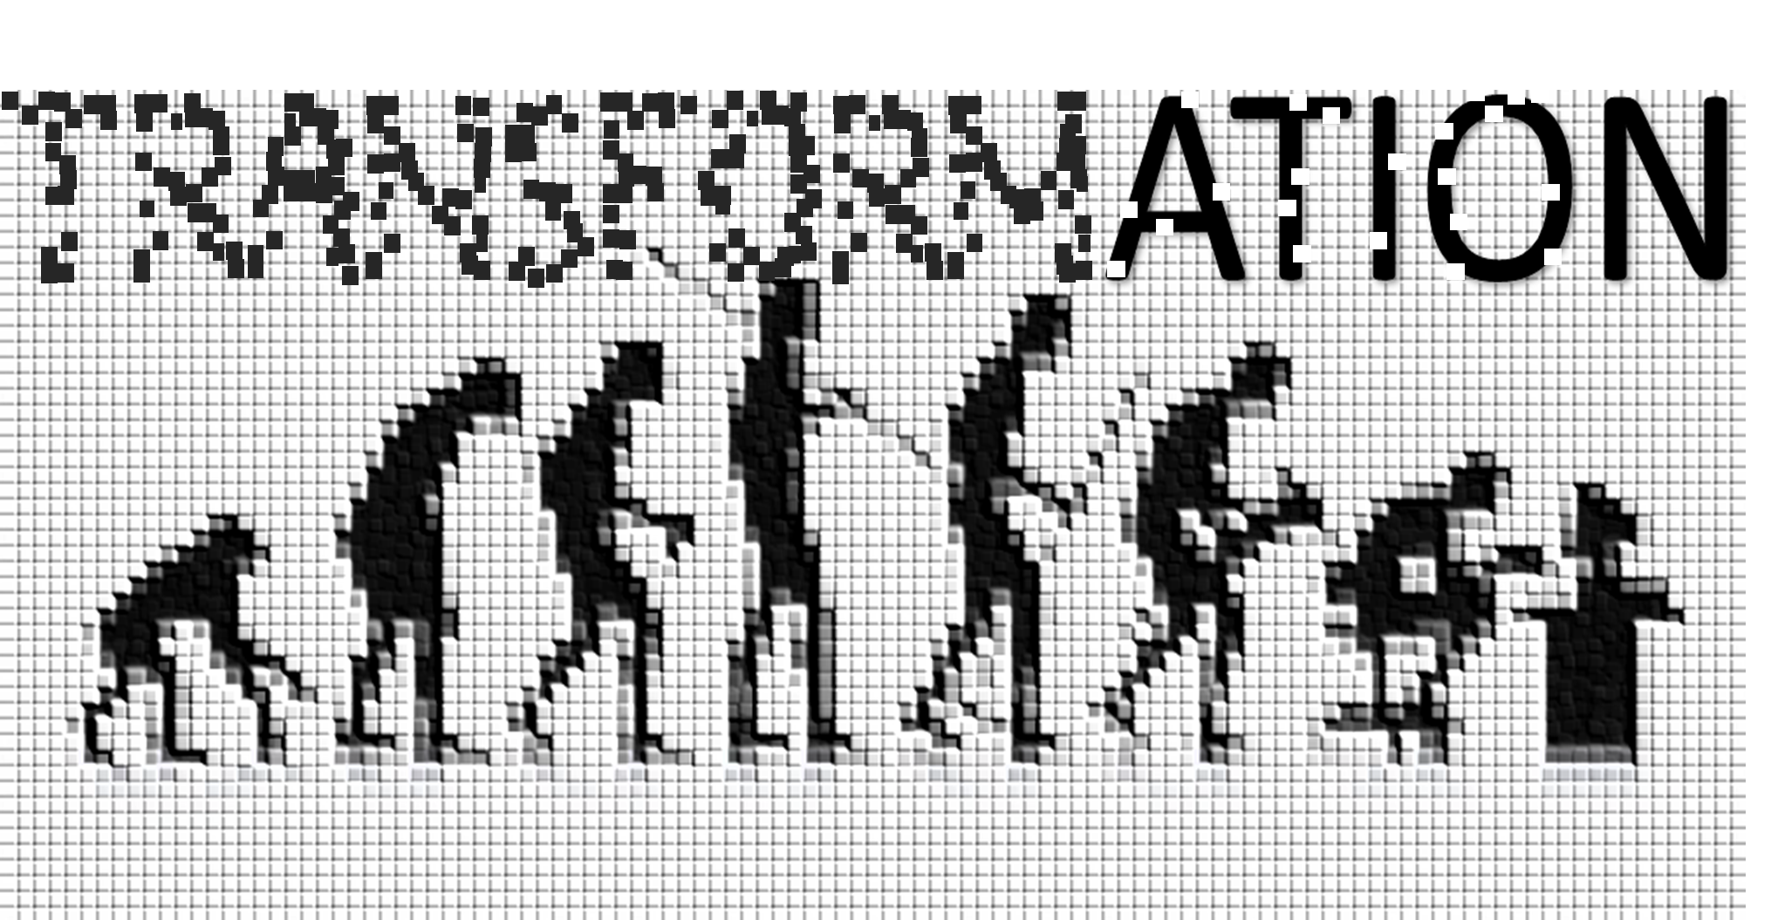

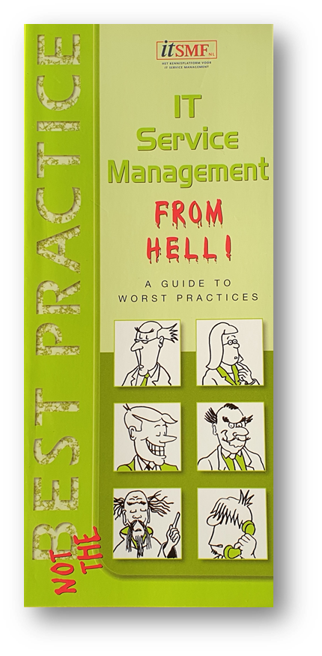
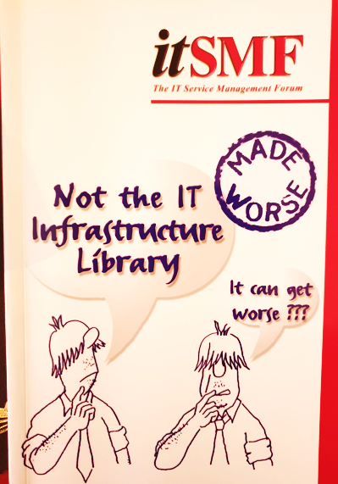




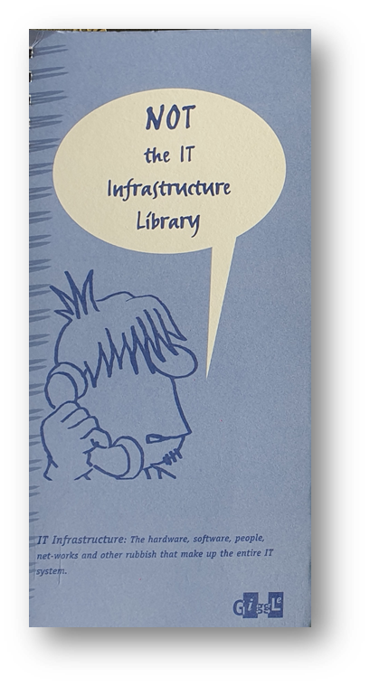

Evolutionary Transformation
….evolution on steroids
2008
2005
Integrated
Business Partner
2002
Value/Outcomes
‘Co-creation’
Services
Value Streams
1998
SLA
Service catalogue
E-2-E Collaboration
Processes
Flow
Principles
ITIL
Agile/DevOps
ITIL4
Technology Provider
From cave dwelling
Technoids…(the mainframe)
Notes:
What are some of the Shiny New things we have discovered in my career?
We have made the transformation from being ‘Technoids’ A term that a CEO used to describe us and our ‘techno jargon’. We made the shift to ‘processes’, ITIL process flows, then we realized it was about services and service catalogues. Delivering services that ‘Customers’ used (too often in IT terms)…
Meanwhile the business was changing, they wanted more agility and speed. ITIL did not evolve quickly enough. Evolution takes time, but we needed an evolutionary transformation (evolution on steroids).
Agile and DevOps came along which we in our ITSM/ITIL SILO ignored, until the complaints and demands grew too strong!
‘Make ITSM more agile’. We developed ITIL4 making the agile World even more upset if we tell them ITIL is THE overarching framework they now to align with. However there is something that ITIL4 gives us, something all the frameworks share. Something we can use to finally align us all – Principles to help us grow into the role of integrated business partner focused on Value and Outcomes!
Which is where we started. This will give use sunshine……however there is a dark storm cloud on the horizon….

Slide 4
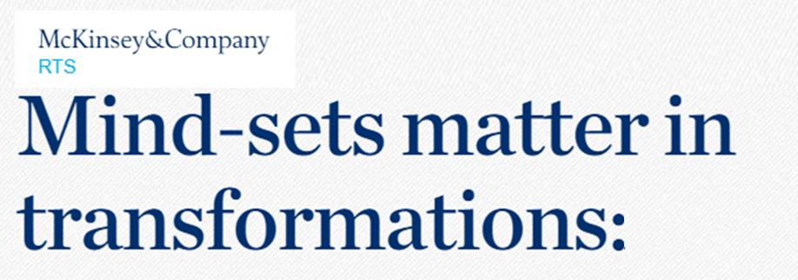

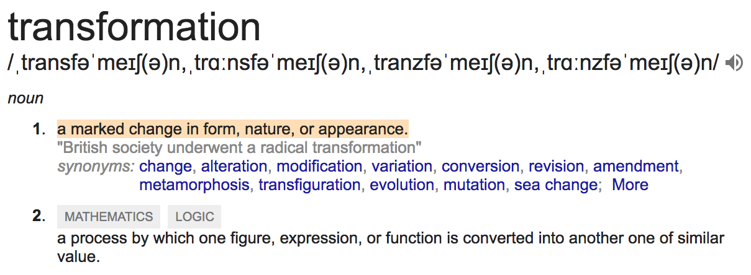
Digital.Disruption
We are digitizing most current business activities. Isn’t that Transformation?
We are updating our website to make our services more accessible.
Isn’t that Transformation?
Didn’t we do our Transformation last year?
‘…research shows
efforts fail 70%
of the time…’
Notes:
What is the dark cloud. Transformation. I have presented this before.
Transformation! Nobody knows what it is but they all want it. Now!
We can see where the confusion comes from, all the definitions are correct.
Whatever Transformation means, one fact is clear. Research shows that 70% will fail
‘mindset matters’.
The word I prefer to use, that sums up what we are going though and ALL need to go through, is ‘metamorphosis’

Slide 5
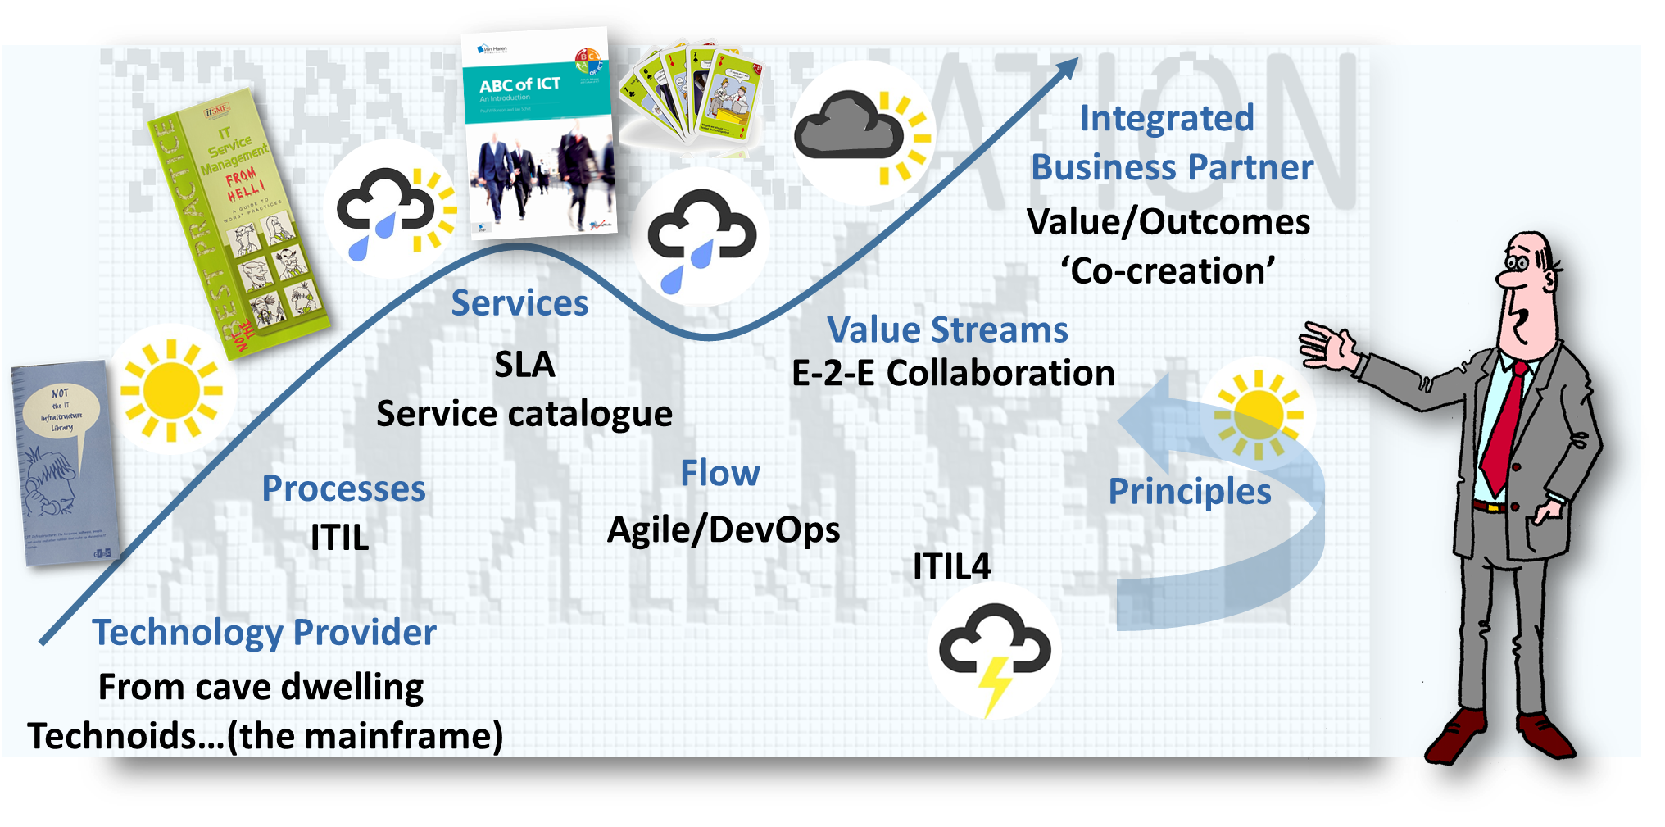

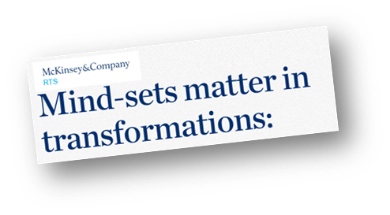
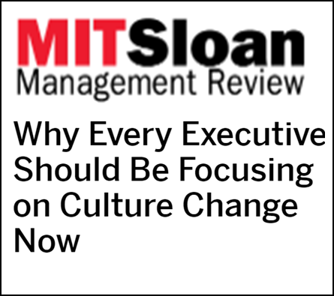
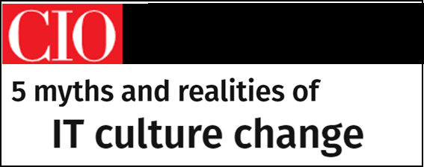
Metamorphosis
“The process of transformation from an immature form to an adult form in two or more distinct stages”
“….understanding how attitudes need to evolve to enable the sort of broad-scale, fundamental change that’s necessary to deliver a real quantum improvement in performance.”
CIOs say they still struggle with IT culture change, even as they recognize that a poor IT culture could hinder or even torpedo digital transformation initiatives.’
ATTITUDE
BEHAVIOR
CULTURE
Notes:
I prefer Metamorphosis because it shows: It is a process that has to go through a number of stages of maturity.
You saw on my evolutionary scale, we have to go through distinct maturity phases.
However there are different ways of looking at what we mean by process.
One problem I see is this process (according to my view): (ABC process)
Mindsets matter we hear……or Culture. Every executive should be focusing on Culture (2021), CIO article reveals we struggle. Why do we struggle? Part of it has to do with this ‘process’ – ABC.
Changing attitudes to create buy-in to adopt new behaviors (sustainable, repeatable behaviors) that eventually become ‘the way we DO things around here’ – fostering a new culture’.
There is not enough time spent on the behaviors. As this MIT article stated ‘……define the desired culture in the form of a compelling set of leadership principles and supporting behaviors…’
We also need to manage the process of transformation, at a pace we can accommodate. Using OCM and change behaviors using OBM skills …

Slide 6


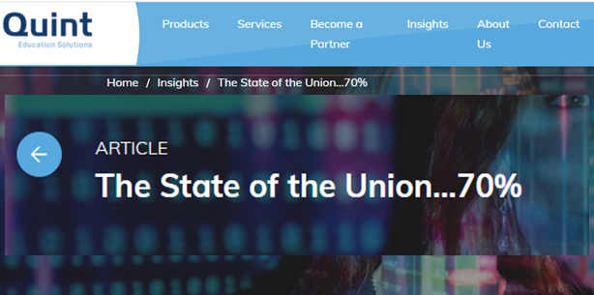





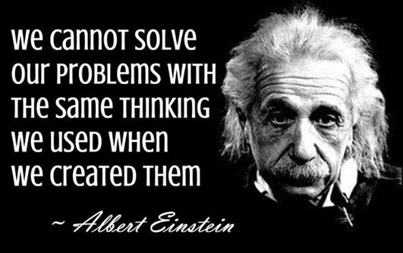
“Groundhog day:
40 years of ‘Oh no, not again!”
“….but it is
so much fun
to try!!....”
Tip1
Read this article and share
the links it contains with those who NEED to
read them!
We could easily have seen this happening….
…and avoided burning our fingers
getting it wrong….AGAIN!
Notes:
And now we have Transformation as the latest ‘Shiny New Thing’.
I have summarized what I see happening with transformation, and the last 40 years as Groundhog day, a film in which Bill Murray wakes up every day and relives the same experiences. That is how I felt, every year when another Shiny New Thing emerged – ‘Oh no, not again’ - and then relive the same experiences.
I decided to look up the state of transformation. Knowing that many if not most will struggle because of ABC.
I wanted to look at the reasons for the 70% failures, taken from various Industry reports, and match these to what we are seeing globally in our simulation workshops.
I wrote this article the State of the Union. As I was reading the Industry reports it made me think of this Quote attributed to Einstein….
But it is so much fun to try’ we keep doing it year-in, year-out.
When I first saw the buzzword bingo term ‘Transformation’ - I could have predicted this was going to happen with my Crystal ball, not because I am smart, but because we keep applying the same approaches…
So what are the reasons for failure?

Slide 7
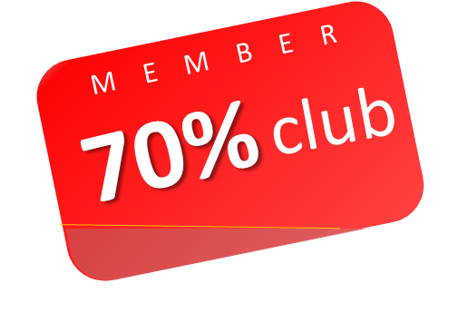

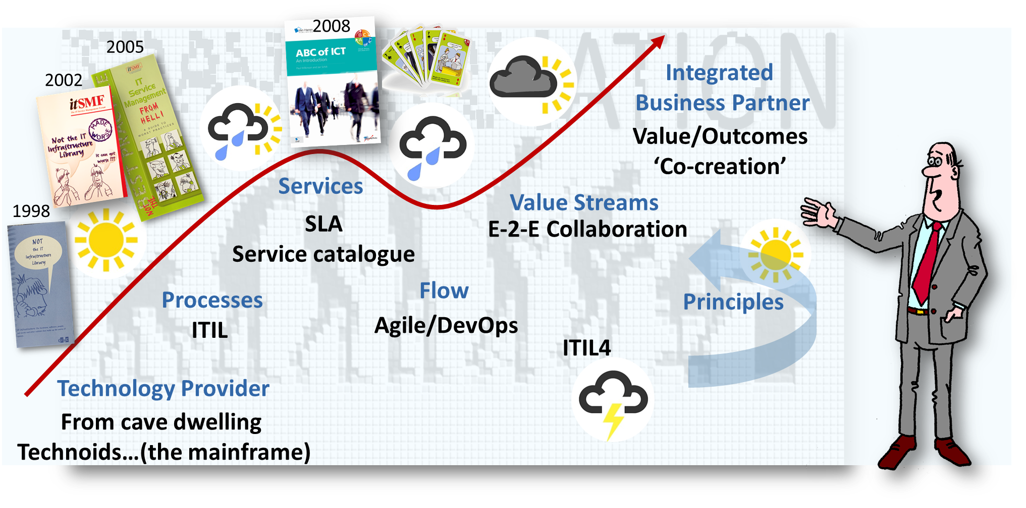

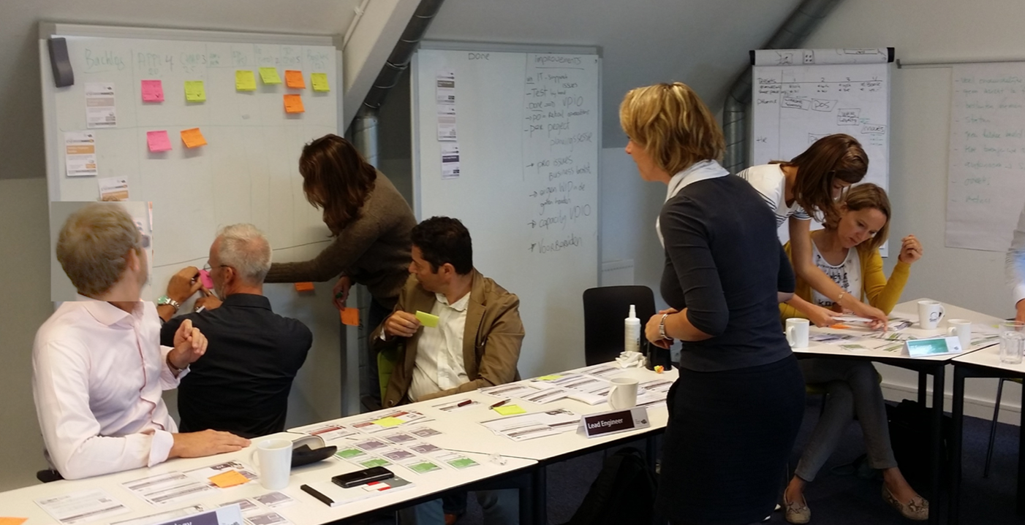

‘agile’ Transformations
Stormy depression
‘70% of digital transformations fall short
of their objectives’
‘70% respondents cited ‘Changing the Culture
is their biggest challenge’
70% do not measure ‘behavior change’ or
‘value and impact’ of their training investments.
70% do NOT have Continual Improvement
as a core strategic capability.
when asked if they ‘measure the actual value realized by new features in their products?’
72% replied “Rarely”, “Once”, or “Never”.
State of DevOps
State of Agile
Gartner research ’10 essential Practices for success in implementing the Scaled Agile Framework
BCG ‘Flipping the Odds of Digital transformation Success’
McKinsey findings ‘How to mess up your agile transformation in 7 easy (mis) steps’,
‘Skills to remain relevant in 21st century and enabling High-Performance Digital organizations.
MIT Sloan Management ‘No one knows your strategy, not even your top leaders’.
Notes:
First of all, these are the Industry reports I read and these were matched to findings from hundreds of simulation workshops.
(you can click on the links, I am happy to send you a copy of this presentation)
All related to agile transformation, that is the metamorphosis we all seem to be making!
However we seem to be sitting in this stormy dip….
I analyzed the reports and our findings from hundreds of simulation workshops and identified 5 common barriers I which are causing these failures. We will look at these 5 common barriers shortly. Are you a member of the 70% club? Cut this out and pin it up on your notice boards, and if people ask what it is tell them. And share with them to 10 post-it tips I will be giving you for your backlog or CSI register.

Slide 8
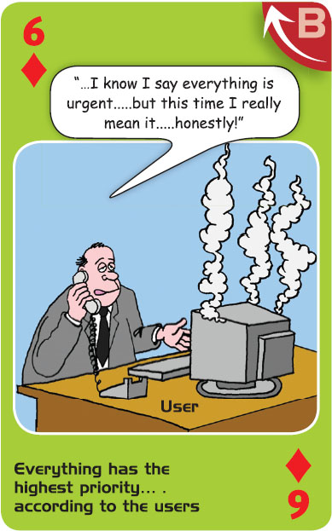
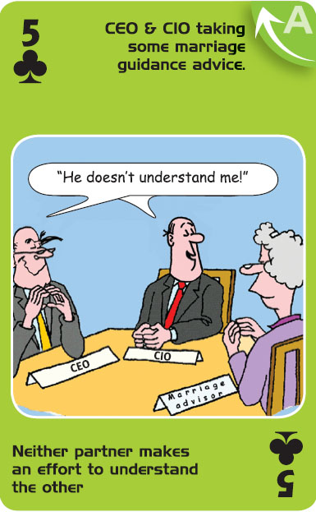
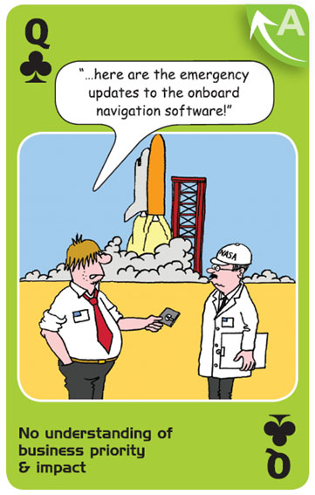
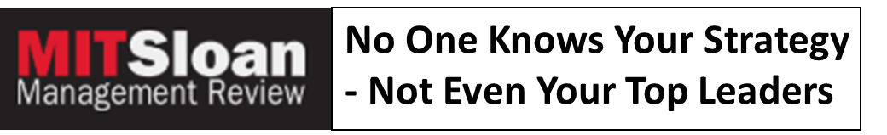

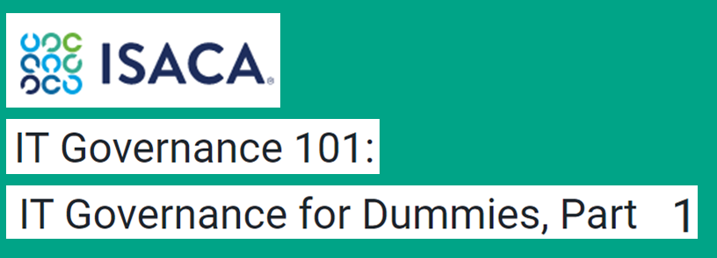
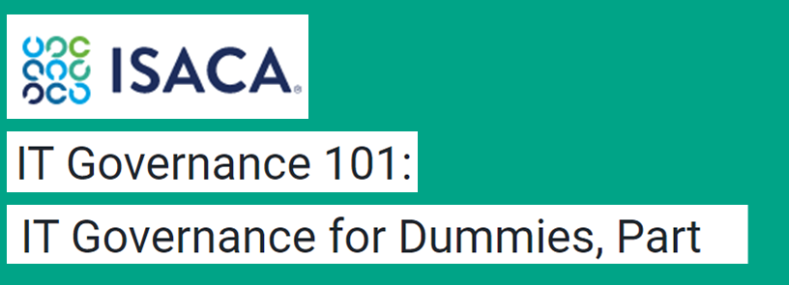
STRATEGIC
1. Not aligning
the initiatives
to strategic priorities and business outcomes
Tip2
Get the CobIT
goals cascade and
go and explore key
goals from different
business units.
Identify priorities
& conflicts
“ What are the top 5 common barriers
in all of the Industry reports and
how does this match the
last 20 years of ABC?”
The CEO was shocked at the results. Only one-quarter of the managers surveyed could list three of the company’s five strategic priorities. Even worse, one-third of the leaders charged with implementing the company’s strategy could not list even one.
‘…a winning hand in Black-Jack….But are you gambling with YOUR IT?...’
Notes:
So what are the 5 common barriers and how do these relate to the last 20 years of ABC – The ‘Groundhog day’ syndrome.
Here is the top chosen ABC card still 15 years in a row.
Here we see it isn’t just IT. Also business behavior. Everything has the highest priority.
We have reached this state. Lack of trust and credibility….
This may be a winning hand in black jack, but are you gambling with your IT. If you recognize this….
As I have said before, only one of these parties can outsource the other.
Who needs to play the marriage guidance counsellor to solve this?
This is the number 1 barrier that all of the Industry reports seem to confirm….Lack of strategic fit!
I wrote these two articles on ISACA about Governance for Dummies, which contains these findings…..yet these are the same business people INSISTING that their Feature has the highest priority…..and we do not know enough about real impact and priority. Without effective governance we cannot hope to solve this.
It is up to us to make change happen if the business doesn’t take ownership…..however we still have a fragmented confusing approach as we try to experiment and discover how…Product Owner, Service Owner, BRM….there are lots of roles pushing to claim the position from their own SILOed position.

Slide 9
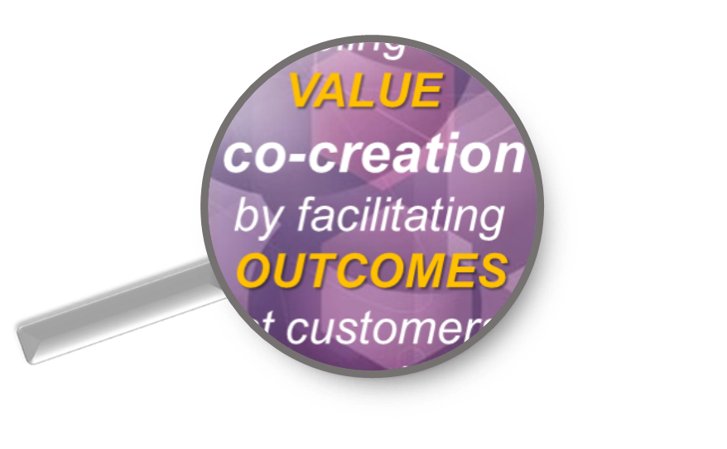

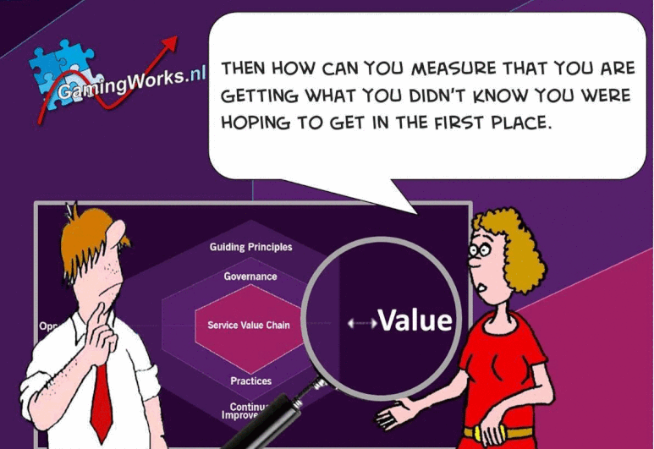
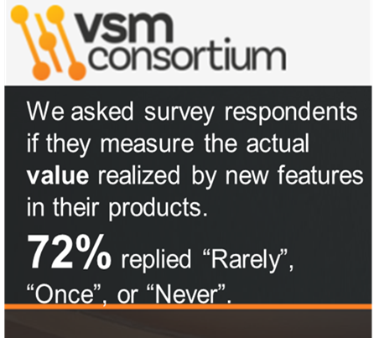
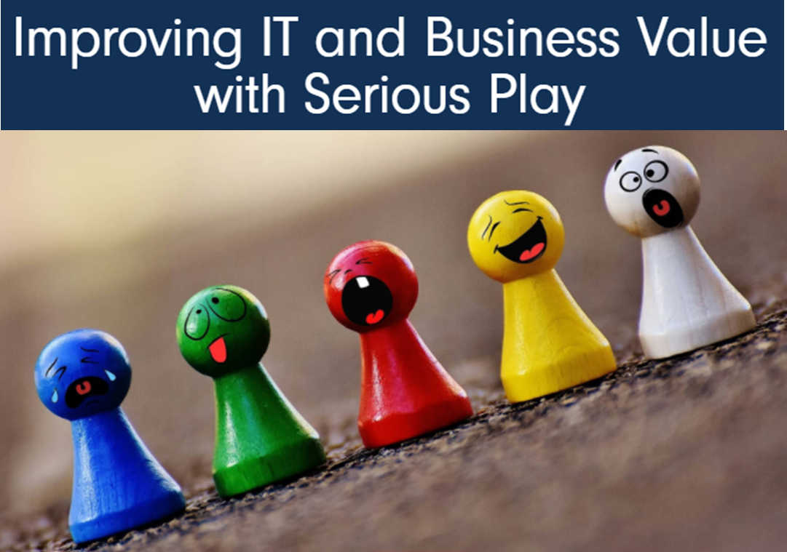
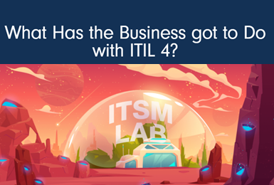


VOCR
“ A means of
enabling
VALUE
co-creation
by facilitating
OUTCOMES
that customers
want to achieve,
without the
customer having
to manage specific
COSTS
and RISKS.”
Tip3
Make Monday
“Go and meet
a user day!”
Send everybody into
the business for
one day.
Explore VOCR!
Notes:
….And what about the IT professionals, not the managers and leaders?
I have asked this of more than 30000 people World wide in conferences ‘How many are doing ITIL’? I usually get more than 70%, How many know the definition of a Service according to ITIL – less that 5%, usually trainers. ‘But we don’t need to know that’!!!
One CEO in a session at a conference said ‘…’
The answer is we don’t!!! This is how well we measure value, perhaps because we still don’t understand what that looks like.
The most powerful word added to the definition of a service…‘Co-Creation’ – something we are poor at.
Here are two example of engaging and ‘co-creating’ the changes necessary for our metamorphosis.
1 – changing the board’s attitude and behavior, 1 the CEO buying to adopting agile ITSM (ITIL4)
TIP: send everybody into business.
‘Make Monday ‘Go and meet a User day’!
This matches a tip fom a recent ELF session with 4 CIO’s ‘get close to customers to understand their problems.

Slide 10
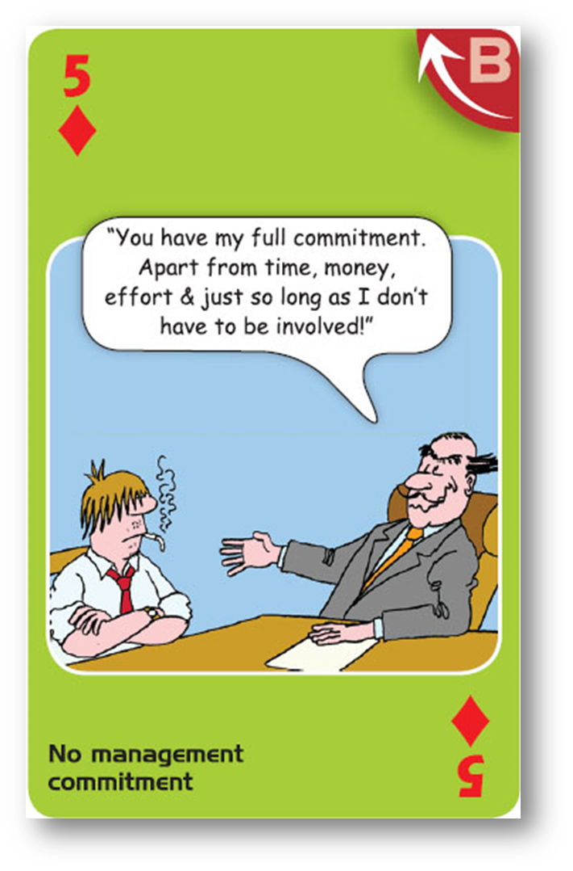
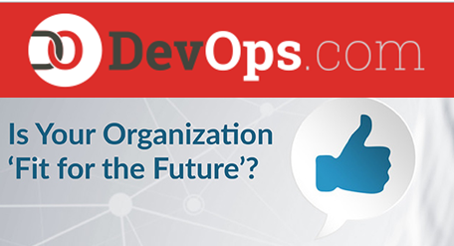
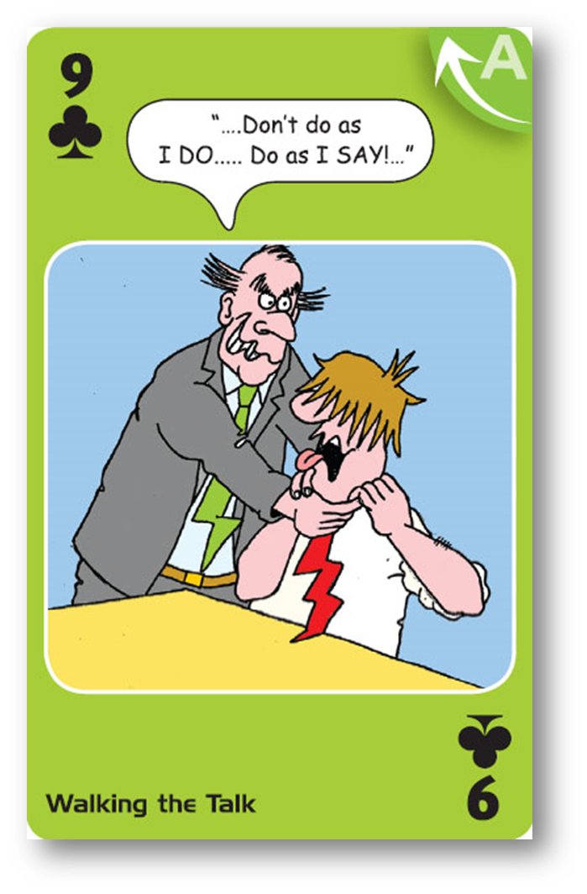
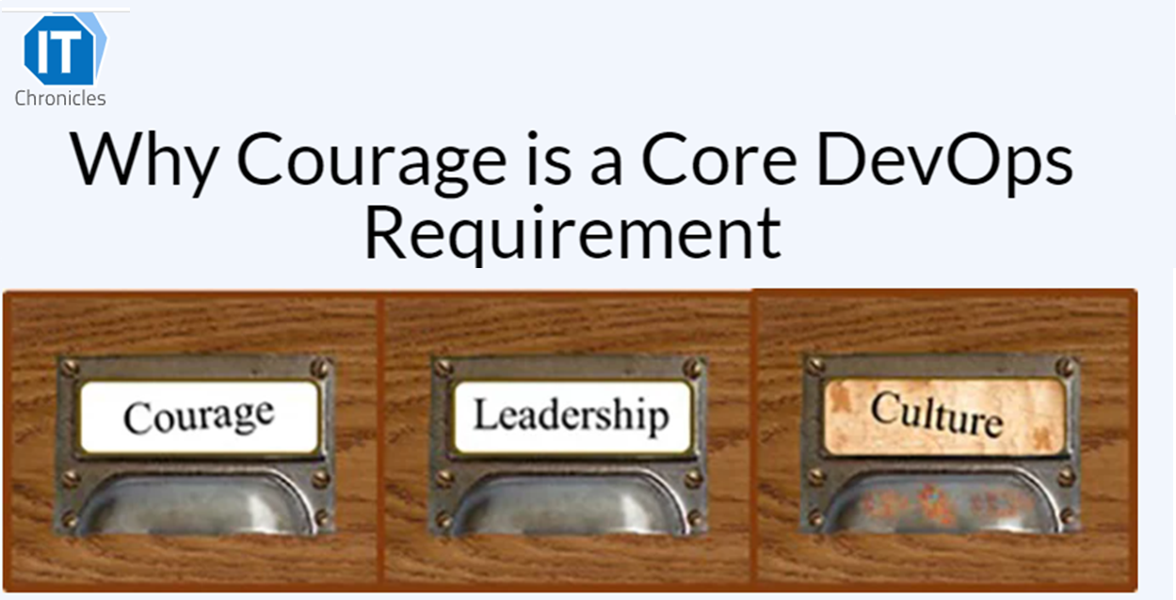
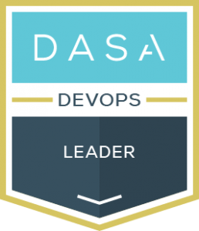
‘L’ for Learner, ‘L’ for Leadership
2. The need for executive and middle management commitment and Leadership skills
Tip4
Define and agree
what 5 key behaviors
demonstrate
Commitment?
e.g.
Reserve time (WIP)
for learning &
Improving!
Tip5
Develop Leadership
skills for
‘New ways of working’
Take a look at
DASA leadership
program
Notes:
L is for Learner and L is for Leader
Here are two top scoring cards.
Managers get angry when they see this. ‘But we ARE committed’
The need for exec level commitment and leadership. Since I started in ITIL more than 20 years ago we have been saying we need more commitment.
This was another key challenge in the state of the union report.
Adopting new agile ways of working requires new leadership styles, skills and behaviors.
This article shows results of a workshop with 15 CIOs.
One said we are expected to walk the talk, but we don’t know what that looks like! It has never been done before!
They admitted they do not have the skills to manage this type of transformation, neither do their direct reports! AND they have not initiated a leadership development program!
Here is an article showing what 2 leadership teams discovered about ‘walking the talk’ – what behaviors they would NEED to display to make the transformation a success.
TIPS Define and agree what ‘commitment’ looks like (look at the article for tips), 1 key, core behavior is this (reserve WIP for CSI)…..
Look at DASA leadership development, developed by ex CIOs who have been through this….

Slide 11
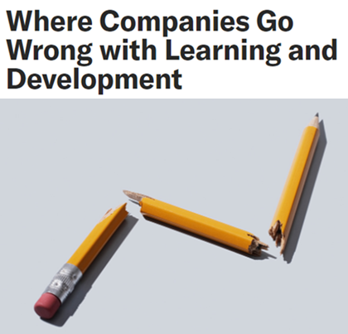
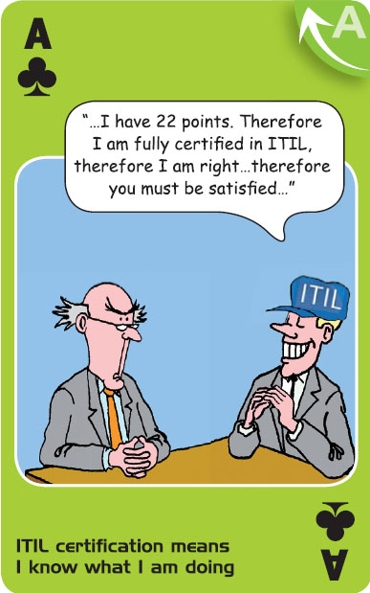
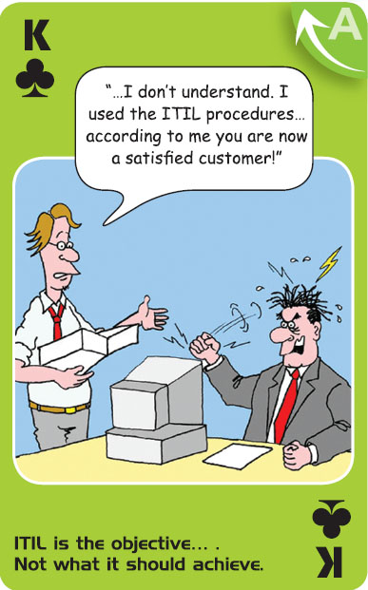
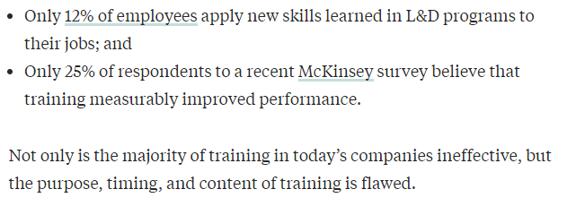




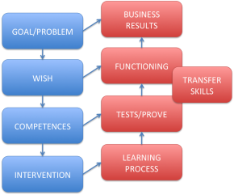
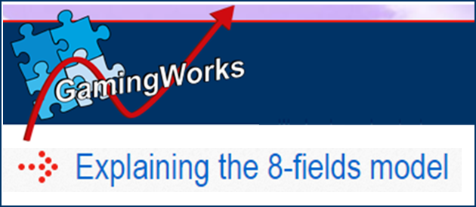
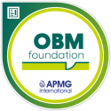
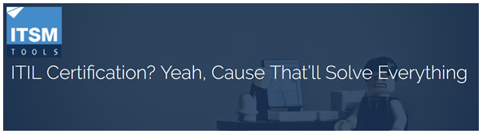
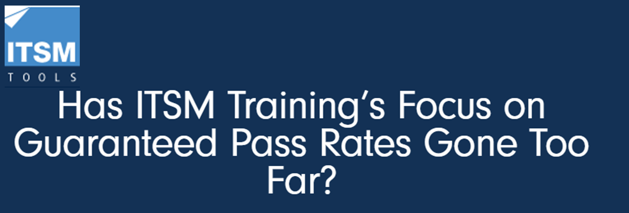
8-Field
3. Not investing in the right skills sets and talents
‘Insanity Is Doing the Same Thing Over and Over Again and Expecting Different Results’
Whilst there
is VALUE in a
Certificate, there is
MORE value in being able to apply theory
into PRACTICE,
in the CONTEXT
of solving a
business NEED”’
Tip6
Use the 8-Field model!
Ask for practical exercises in training
Start measuring!
Look at OBM
training!
Notes:
Insanity is doing the same thing over and over again….
This is my pet topic and has been for more than 20 years….
These 2 cards – you can replace ITIL with any other framework, such as agile or DevOps
Not investing in the right skill sets and talents was anther common barrier, talking about technical skills, leadership skills and soft skills….I want to stress the certification challenge!
I wrote these 2 articles that looked at this.
The ‘Hunt for the certificate’ what shiny new certificate should I get next? The framework or the certificate is the goal. Not what we want to do with it.
I have always said ‘ Whilst there is value in the certificate there is MORE value in being able to apply the theory in practice, in the context of solving a business problem‘
This next article shows why we need this….the 8-field model. Here was a white paper on the axelos website – you can no longer access it through the website, they removed it as it is old content! The link is attached to this image.
I won’t explain the model here you can read about it but basically the right side talks about measuring the impact of training.
We are good at the lower levels evaluation the training/trainer, passing the test, but poor at the top 2, measuring theory is being used in practice and impact…….This Harvard survey matched some of our global findings….only 12% apply skills in practice, 25% measure impact!

Slide 12





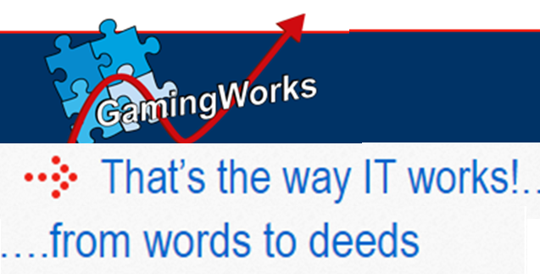
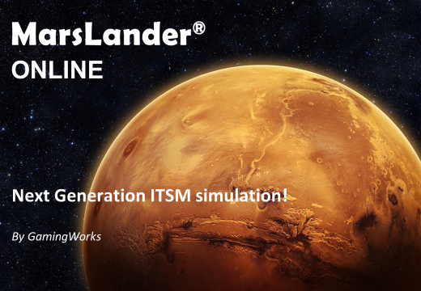


IMPORTANT!
Start measuring!
1st call resolution went up from
65% to 75% , representing 40000
additional calls resolved, saving
250.000 Euro and the business
outcome? improved patient care
and patient safety
8-Field Model
2013
32% score 8+ on “My work is more effective and efficient” (47% 7+)
29% score 8+ on “ITSM CSI initiative” brings results” (41% 7+)
34% score 8+ on “CSI has improved my work” (47% 7+)
Theory into Practice
Notes:
Two examples of measuring……People keep telling me that you can’t really measure it. Really!
We applied the 8-field model. Used the simulation to translate theory into practice, captured takeaway actions and agreed new behaviors…..then we measured ‘Practice’ and ‘Impact’
This article shows specific behaviors we measured such as ‘consistently recording relevant information’
Just to show you how important this is…….

Slide 13
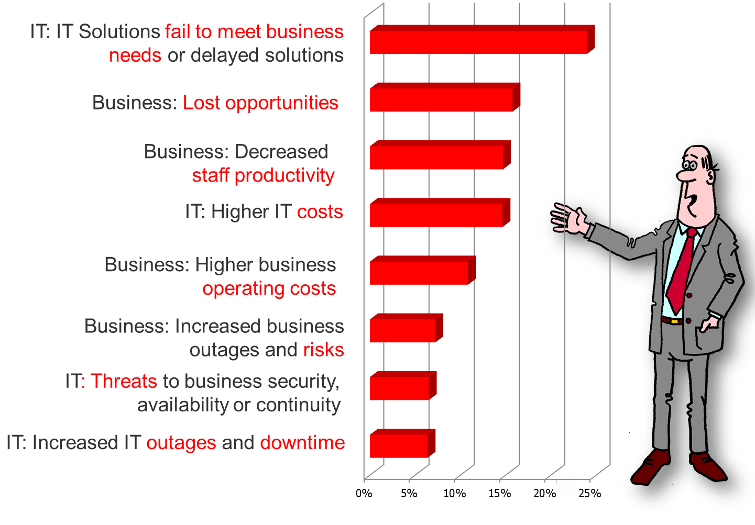
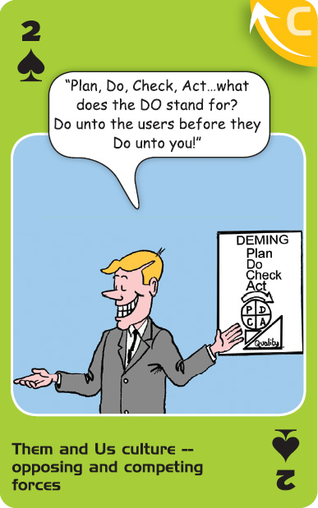
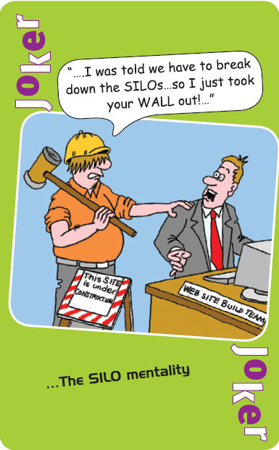
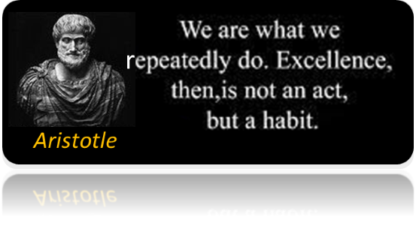
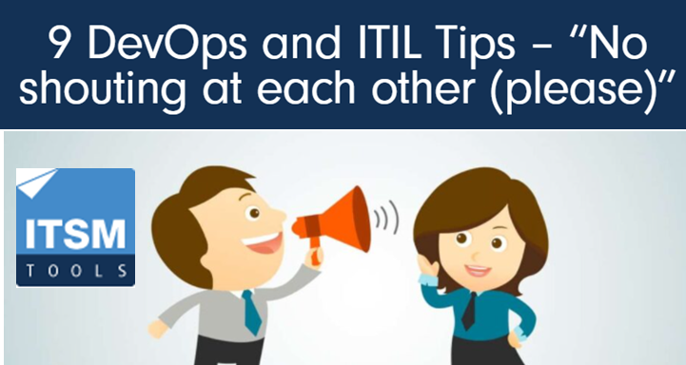
C = A+B+C
McKinsey: ‘70% respondents cited ‘Changing the Culture is their biggest challenge’
State of Agile: 43% ‘Organizational culture at odds with agile values’
State of DevOps (Dev) ‘…The report findings are clear—what we’ve historically called “cultural factors” are a major barrier to high performance IT’ citing as reasons ” Negative leadership behaviors” “lack of trust”, “resistance to change”, “Insufficient feedback loops”
State of DevOps (OPS) ‘…And now, in perhaps the biggest shift of all, the expectation is that we have people skills and can collaborate effectively with different functions’.
4. Culture was, is, and remains a key barrier – as well as organizational resistance to change.
Tip7
Get a set of ABC
cards and use to assess YOUR undesirable ABC!
Explore real examples
of VOCR lost
Prioritize
improvements
Practice, Feedback,
Coach
Notes:
The SILO culture, just one example of Attitude, Behavior, Culture issues.
What did the findings say from the State of the Union discoveries?
Here is another article related to ‘collaboration’ and breaking down the SILOes.
Why should we worry about this? What is the impact. We asked people in our ABC workshops to discuss real life examples related to each card they chose and then discuss what was the impact on VOCR? These were the results. Look at the impact.
‘ Impacting the whole purpose of agile and digital transformations ‘failing to meet business needs or delayed solutions’
15 years in a row? Why we don’t address leadership skills and behaviors.
Here is an article bringing Dev and Ops together in a sim and having them switch roles to help change attitudes…’oh now I understand why….’
Key tip practice, practice, practice with feedback and coaching. As was attributed to Aristotle : We are what we repeatedly do, Excellence then is not an act but a habit

Slide 14



Communication & Collaboration skills
……are make or break
Menu
We listen to give an answer
rather than listen to understand.
Assumicide causes waste, delays,
rework, frustration, irritation.
Nobody KNOWS what collaboration means!
.....so how will they know how to behave?
Effective collaboration
We prioritize based on goals
We confirm understanding
We stick to our agreements
or give timely notifications
We offer and ask for help
We give constructive
feedback
We reflect and improve
end-to-end
We respect each others input
Tip8
Develop & practice
active listening skills
Define & agree 7 behaviors
for collaboration.
Practice/Feedback/Coach
Get together to map out
e-2-e flow, identify
improvements, identify
conflicts in goals!
Notes:
Communication & collaboration skills scored top in a skills survey recently.
This is something that surprises me in all of our simulation workshops. How poorly we in IT communicate, and also how poorly we collaborate.
Once again you saw these are also top scoring cards ‘them & us’ – failing to effectively collaborate and break down SILOes!
Nobody really knows what collaboration is define and agree these behaviors. A great way to:
Improve communication and collaboration AND capture end to end improvements AND to focus on value is map out end to end flows of work.

Slide 15



Communication & Collaboration skills
……are make or break
“….companies lose about 50% of knowledge in every handover.
This means that after 5 handovers the leftover knowledge is only 3% of the total amount that initially started to flow.
Source: Poppendieck, Implementing Lean Software Development.
3%!....I guess I’ll just have to ASSUME…
Reduction in number of ‘Yes but’s’ in a meeting’.
METRICS
that
MATTER
Reduction in ‘Unanswered questions’ in a meeting.
Reduction in number of ‘Interruptions’ when somebody is talking
Increase in ‘Summarizing decisions’ and ‘Actions’ in a meeting
Increase in ‘Confirming understanding’ to avoid assumptions.
Notes:
Here is an example of the impact of poor communication.
After 5 handovers only 3% flows….What can we do to stop this? Develop some KPI’s…again, these are desirable collaboration behaviors
This will help practice active listening!

Slide 16








Principles.
From Posters to Performance
“…a fundamental truth or proposition that serves as the foundation for a system of belief or behavior…”
Linking the Value chain of best practices together!
Having ‘desirable behaviors’ Flow end-to-end.
Tip9
Define and agree
which behaviors do
we want to ‘learn’
and ‘unlearn’
Send this link below
to your CIO
Notes:
I showed the importance of Principles in my opening sheets.
What is the definition of principles…..a system of belief, mindsets….many stop here, simply hang them up as posters, but I also showed you it is all about ‘behaviors, a foundation for a system of behavior.
All of these ‘new agile ways of working’ frameworks have principles. These are the principles for agile, DevOps (DASA), Lean, ITIL4. I analyzed them and identify 3 common CORE principles.
These are what link us together…..These should be translated into sustainable, repeatable behaviors, we have already seen a tip around defining collaboration behaviors….do the same with these ‘what behaviors do we want to see that demonstrates this’?
Here are some articles showing examples. One of them talks about passing behavioral defects downstream, without ‘feedback’ this becomes the norm, when we accept undesirable behavior, an important aspect of effective collaboration is safety to give and receive open feedback.
This article on CIO at the watercooler explains for your CIO the importance of this! Share this with your CIO! Or management team.

Slide 17




….It is if you are not doing it!
CSI – Crime Scene Investigation?
McKinsey:
‘Misstep number 7
Not infusing experimentation and iteration into the DNA’ ( Culture)
BCG: ‘An agile governance mindset’ that includes ‘adapt to changing contexts’, ‘address roadblocks quickly’, ‘fail-fast-learn’
5. It is not about ‘Implementation’! Continual learning and improving are core capabilities
Governance: “...a person or group of people who are accountable at the highest level for the performance and conformance of the organization”
29%
“The Governing body should also have visibility of the outcomes of
continual improvement activities and the measurement of value for the organization...”
Notes:
Plan do Stop, another top 10 card….This is also one of the common challenges from the State of the Union.
As I often state in my sessions.
Nobody has ever implemented one single ITIL process from 0 to optimized maturity in one go. It is NOT possible, nobody has ever implemented all ITIL processes in one go, therefor ITIL is nothing more than a continual improvement approach. Yet when I ask at conferences….
Many put their hands up when I ask ‘how many are doing CSI’. But then I say what I mean is top-down (strategic to operational) and left-to-right (through the value chain), very few hands go up.
Yet DevOps surveys show, organizations that embed this as a core capability have 29% more time to work on more value adding work.
This to me should be a CORE capability for every IT organization.
Too often too little time is reserved for this.
Also look at this, this is in the ITIL Foundation level book. It needs to feed into Governance – It is part of a strategic capability, but I believe IT Governance isn’t a topic in the ITIL Foundation level class. I assume that means ITIL foundation isn’t meant for strategic managers or those needing to align ITIL with IT governance and strategy!

Slide 18








Transfer of Learning
Tip10
Make Progress iteratively
with feedback a CORE
capability.
Visualize improvements
and progress
Notes:
Here is an example of how we use this in our online simulations. Between each game round.
At the end of the day I ask. How long did it take to go through this between rounds – 30 minutes.
Imagine if you did this each week. Imagine how many improvements in a year?
Many teams complain they are not given time for retrospectives or time to work on improvements. They can’t find the time. Or time is stolen back from them. You don’t find the time you make the time, this requires management commitments. I wrote this article. If time is our most PRECIOUS CURRENCY the how are we spending it, investing it, wasting it? Stealing it?

Slide 19

There is a clear need to extend training to include
Both business & IT Leadership – to create an understanding and foster commitment to the effort and iterative approach needed.
Governance of Enterprise IT within an agile context – to ensure a strategic fit and effective devolved decision making.
Organization Change Management – to effectively manage change and use resistance as an enabler.
Organizational Behavior Management – translating ‘mindsets’ and ‘cultural values’ into sustained, desirable behaviors.
Leadership development to develop the right skills, behaviors and leadership styles lead an agile transformation, to manage in an agile organization, and to sustain and grow agile cultural values.
Coaching at all levels – to help transfer and embed learning and to embed an iterative cycle of practice, feedback, improve.
Ensuring end-to-end representation in training – To help break down SILOes and foster collaborative learning. (e.g. participation in a business simulation).
Ways to translate theory into practice – include ‘Learning-by-doing’, supported by coaching.
An approach such as the 8-Field model – to ensure learning interventions fit with strategic intentions, the transfer of learning into the organization, and the ability to measure behavior change and impact (Value).
Linking the outcomes from training to continual improvement initiatives – recognize and embed the need for continual learning and improving.
Notes:
These are my top 10 tips at the end of the state of the union article. I am not going to stop and name them. You can read the article or ask for a copy of this PPT.
Or take a screen shot, many were covered in my tips.

Slide 20

The Shiny New Thing that Really Helps!
Maybe it is time to rebrand and repackage the ABC of ICT and call it ‘The Shiny New Thing that really helps’. Perhaps people will then want it. I will immediately get a load of emails asking where they can get ‘The Shiny New Thing that really helps’ foundation certificate and consultants will be saying that they already have years of expertise with shiny new things, asking where they get the fast track bridging certificate to the Master certificate in ‘The Shiny New Thing that really helps’? And tool providers will be declaring that their tool is ‘The Shiny New Thing that really helps’ compliant.
Notes:
..the thing is if I suggest a presentation on ABC people say ‘we have done that! Haven’t you got anything new (and shiny)….’
So what is the shiny new thing that really helps? It is ABC of ICT repackaged, I suggested if I start promoting it as new people will want the certificate….
As you can see bold text looks good, small print shows nothing has changed….It is still just as relevant

Slide 21




Questions?
p.wilkinson2211@outlook.com
p.wilkinson@gamingworks.nl
Notes:
Finally, another top scoring card. You are the only person who has seen this and seen the post-its that need sticking up on backlogs. Yet many think ‘not my responsibility’
I wanted to make a T-shirt to remind us, we are now strategic assets, but something went wrong with the font. But actually it is quite appropriate..
If you want to be the strategic asset that we need to be, take the post-its and DO something with them, otherwise……

